Slide 1
COMP3017 Service Computing

Slide 2

Module Six: Service Engineering

Slide 3
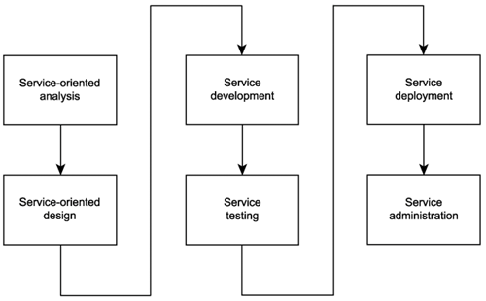
SOA delivery lifecycle

Slide 4
Service-oriented design
Service-oriented design is the process by which concrete physical service designs are derived from logical service candidates and then assembled into abstract compositions that implement a business process.

Slide 5
Analysis in this process
How can physical service interface definitions be derived from the service candidates modeled during the service-oriented analysis phase?
What SOA characteristics do we want to realize and support?
What industry standards and extensions will be required by our SOA to implement the planned service designs and SOA characteristics?

Slide 6
Objectives of service-oriented design
Determine the core set of architectural extensions.
Set the boundaries of the architecture.
Identify required design standards.
Define abstract service interface designs.
Identify potential service compositions.
Assess support for service-orientation principles.
Explore support for characteristics of contemporary SOA.

Slide 7
"WSDL first" Service Design
Before we can develop a service, we need to have defined the interface of that service - "WSDL first"
Defining the service interface prior to development is important to establishing a highly standardized service-oriented architecture and required to realize a number of the characteristics we identified as being part of contemporary SOA

Slide 8
Who should participate in this step?

Slide 9

Open Question
Points: 10
What kind of expertise is required to define the above documents?
Open Question is only supported on Version 2.0 or newer.
Answer

Slide 10
Who should participate in this step?
Best defined by those who understand the enterprise technical environments the most

Slide 11
Who should participate in this step?
Best defined by those who understand the enterprise technical environments the most
Business analysis expertise not required

Slide 12
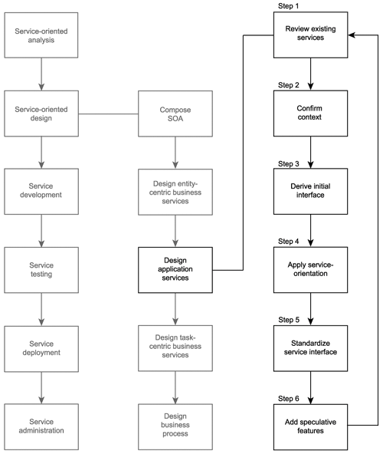
Service-oriented design
Design application services

Slide 13
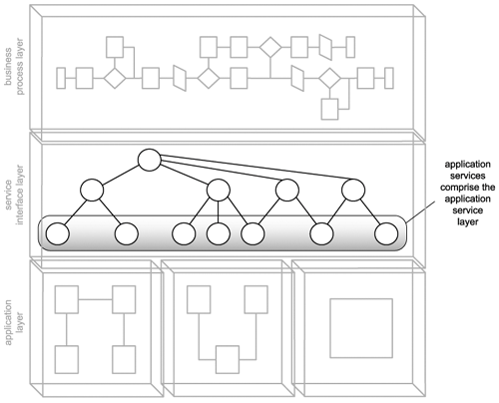
Design application services

Slide 14
The design of the Transform application service candidate

Slide 15
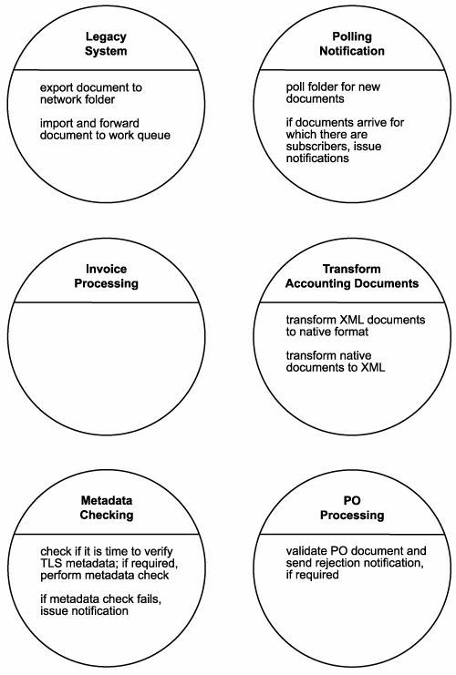
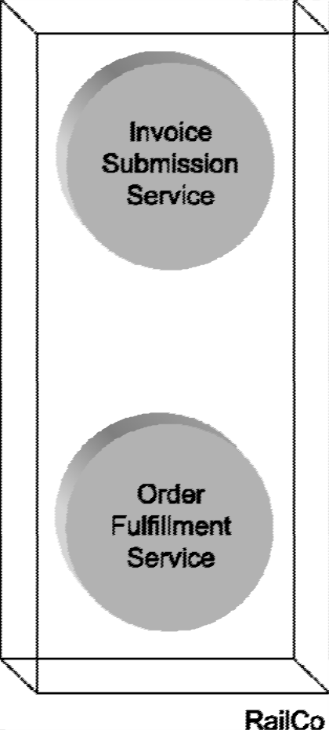
Recall RailCo’s service candidates
Old design
New service candidates

Slide 17
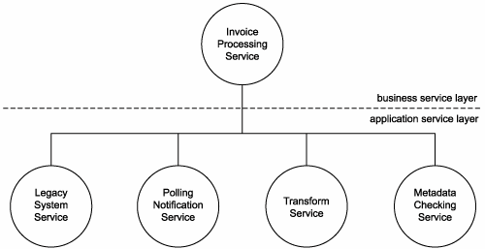
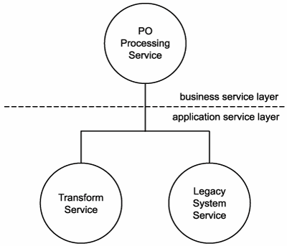
Recall RailCo’s service candidates
Old design
New service candidates

Slide 18
Transform Service

Slide 19
Transform Service

Slide 20
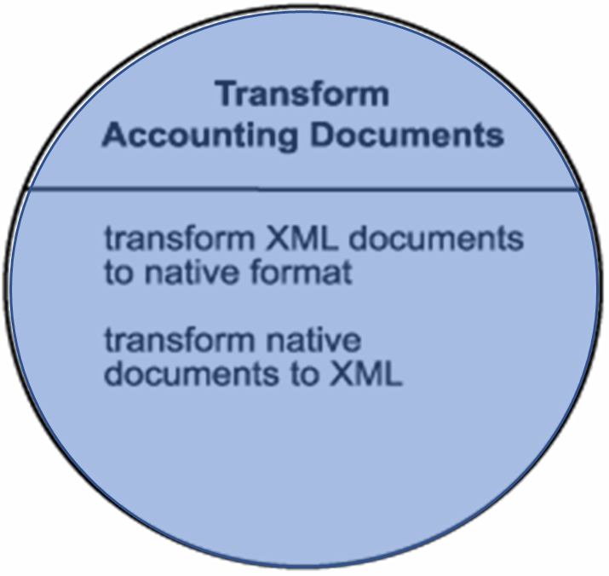
Transform Service

Slide 21
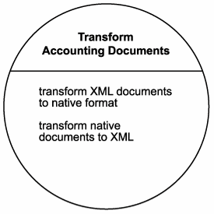
Service Design - Transform Service
This candidate establishes a "document transformation context," which justifies the grouping of its two very similar operation candidates:
transform XML documents to native format
transform native documents to XML

Slide 22
Today we will study some design decisions that RailCo has made when developing this service

Slide 23
Service-oriented design

Slide 24
Step 1: Review existing services
Check existing services for redundant features.

Slide 25
Step 1: Review existing services
Check existing services for redundant features.
Check if the required feature can be purchased or leased from vendors.

Slide 26
Step 1: Review existing services
Check existing services for redundant features.
Check if the required feature can be purchased or leased from vendors.
Checking names, service descriptions and metadata of existing services (i.e. TLS Subscription Service), RailCo concludes that no overlap exists

Slide 27
Service-oriented design

Slide 28
Step 2: Confirm context
Reassess service context if operation candidate grouping from the analysis phase is appropriate, e.g. operations may better belong in other services.

Slide 29
Discussion
Why there is a need for the design phase to reassess what was already decided during the analysis phase?

Slide 30
What expertise is required?
Business
Technical

Slide 31
Step 2: Confirm context
Reassess service context if operation candidate grouping from the analysis phase is appropriate, e.g. operations may better belong in other services.
Review of Transform Accounting Documents service against TLS Subscription service confirms that grouping context is valid.

Slide 32
Service-oriented design

Slide 33
Step 3: Derive an initial service interface
Confirm that each operation candidate is suitably reusable and its granularity is appropriate.

Slide 34
Step 3: Derive an initial service interface
Confirm that each operation candidate is suitably reusable and its granularity is appropriate.
Define definition of messages the service is to process (i.e. WSDL <types> area) using XML schema.
Establish a set of operation names and define WSDL <portType> with <operation>.
Define WSDL <message> with <part>.

Slide 35
A quick review of most relevant information about WSDL

Slide 36
Web Service Protocol Stack
Discovery UDDI
Description WSDL
Describing Web Services interface
XML Messaging XML-RPC, SOAP,XML
Transport HTTP,SMTP,FTP, BEEP

Slide 37
A client program reads a WSDL document to understand what a Web service can do; then it uses SOAP to actually invoke the functions listed in the WSDL document.

Slide 38
Service Description
WSDL provides a notation to answer the following three questions:
What is the service about?
Where does it reside?
How can it be invoked? (i.e., what, where, and how)

Slide 39
What is WSDL
WSDL is a specification defining how to describe web services in a common XML grammar.
WSDL describes four critical pieces of data:
Interface information describing all publicly available functions
Data type information for all message requests and message responses
Binding information about the transport protocol to be used
Address information for locating the specified service

Slide 40
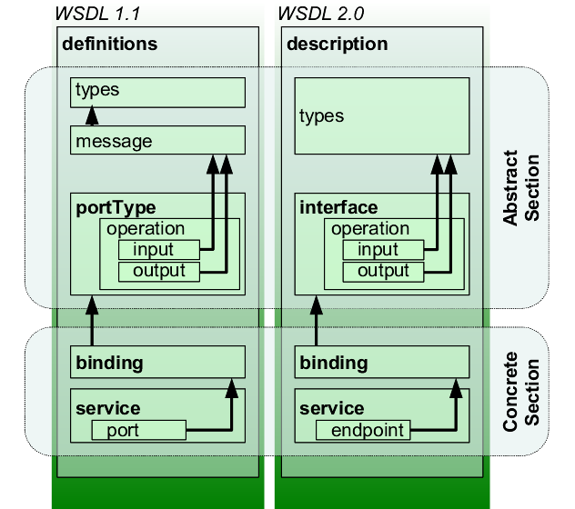
WSDL
An XML-based interface description language
Used for describing the functionality offered by a web service
WSDL describes services as collections of network endpoints or ports

Slide 41
WSDL Specification major Elements
definitions
types
message
portType
binding
service

Slide 42
Back to our example

Slide 43
Step 3: Derive an initial service interface
Confirm that each operation candidate is suitably reusable and its granularity is appropriate.
Define definition of messages the service is to process (i.e. WSDL <types> area) using XML schema.
Establish a set of operation names and define WSDL <portType> with <operation>.
Define WSDL <message> with <part>.

Slide 44
Step 3: Derive an initial service interface
Define definition of messages the service is to process (i.e. WSDL <types> area) using XML schema.
Establish a set of operation names and define WSDL <portType> with <operation>.
Define WSDL <message> with <part>.

Slide 45
Activity
Let’s first brainstorm potential names for the operations of our service

Slide 46
Open Question
Points: 10
Currently the candidate service operations in the Transform Service are called
transform XML documents to native format
transform native documents to XML
Propose two names for the operations of our service that can be used in WSDL file.
The name should be as short as possible, yet descriptive enough to understand the function of the operation.
Open Question is only supported on Version 2.0 or newer.
Answer

Slide 47
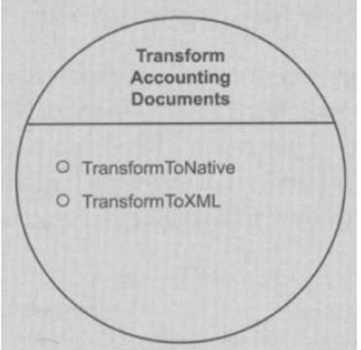
Confirm that each operation candidate is suitably reusable and its granularity is appropriate
RailCo begins by the two operation names shown here
It then moves on to define the types construct of its service definition to formalize the message structures

Slide 48
Define definition of messages the service is to process (i.e. WSDL <types> area) using XML schema

Slide 49
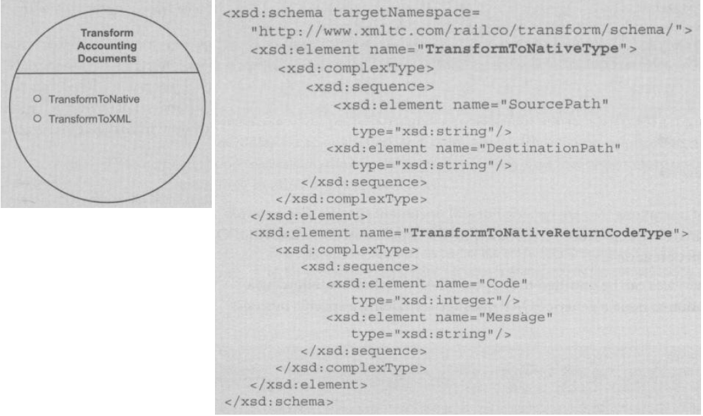
types for the TransformtoNative operation

Slide 50
Activity
We have designed the types for the TransformtoNative operation
The next step is to design the types for the TransformtoXML operation

Slide 51
Discussion
We observe, that the types for the second operation are the same as the first operation – in such case, the same schema for these two operations be shared?

Slide 52

Poll
1 answer(s) at most
We observe, that the types for the second operation are the same as the first operation – in such case, the same schema for these two operations be shared?
A
YES
B
NO
提交

Slide 53
Multiple Choice(single)
Points: 1
We observe, that the types for the second operation are the same as the first operation – in such case, the same schema for these two operations be shared?
A
YES
B
NO
提交

Slide 54
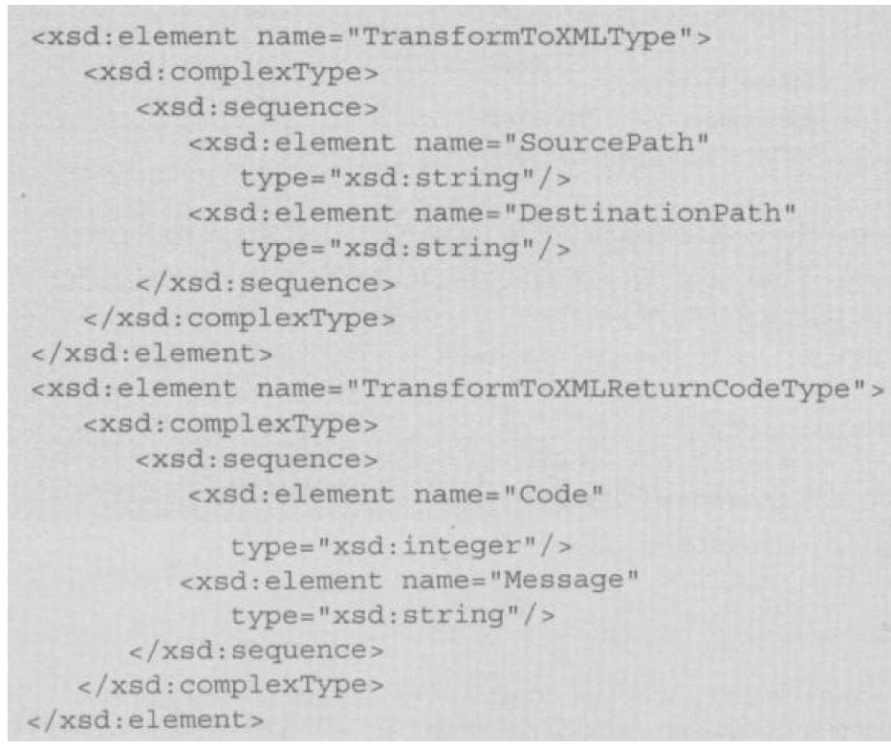
Types for TransformToXML are identical to those of TransformToNative and can be shared. But RailCo decides to keep a separate schema.
What is the benefit of this decision?

Slide 55
Open Question
Points: 10
Even though types for TransformToXML are identical to those of TransformToNative and can be shared, however RailCo decides to keep a separate schema.
What is the benefit of keeping these two schema in separate files?
Open Question is only supported on Version 2.0 or newer.
Answer

Slide 56
Types for TransformToXML are identical to those of TransformToNative and can be shared. But RailCo decides to keep a separate schema to have freedom to change them independently.

Slide 57
Define WSDL <message> with <part>

Slide 58
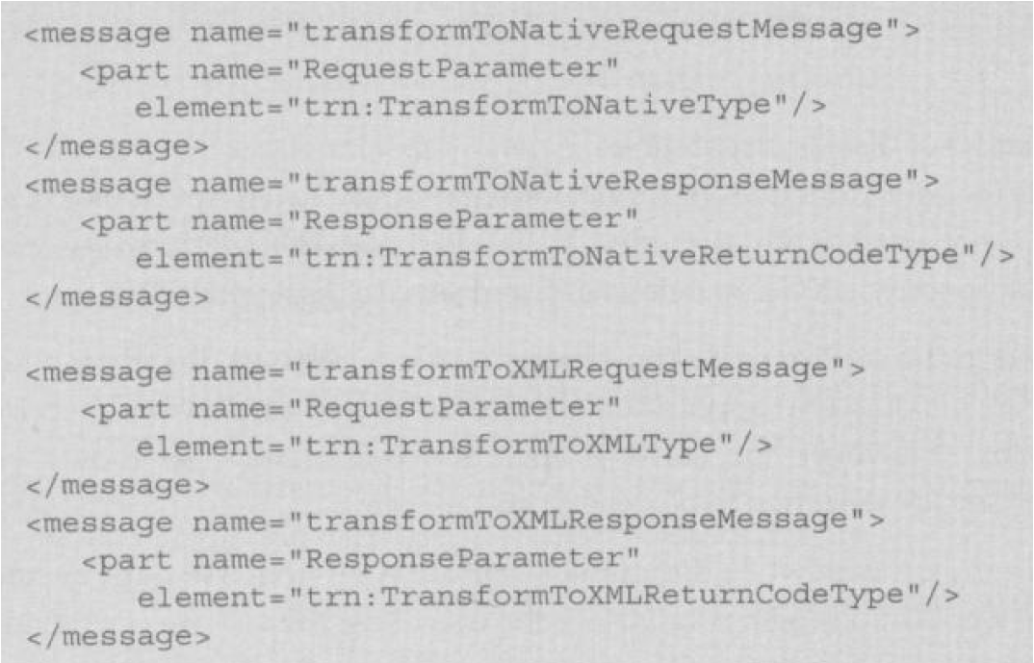
Define WSDL <message> with <part>

Slide 59
Establish a set of operation names and define WSDL <portType> with <operation>

Slide 60
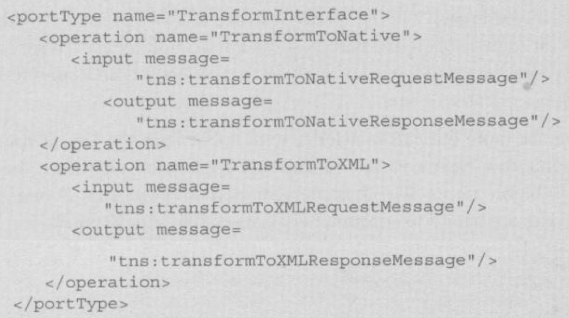
Establish a set of operation names and define WSDL <portType> with <operation>
Now the initial version of the abstract service definition for the RailCo Transform Account Document Service is completed

Slide 61
Service-oriented design

Slide 62
Step 4: Apply service-orientation
Revisit reusability, autonomy, statelessness, discoverability

Slide 63
Discussion
Service orientation was already applied during the analysis phase. Why do we need to do it again?

Slide 64
Open Question
Points: 10
Remark
Service orientation was already applied during the analysis phase. Why do we need to do it again?
Experts from different domains participate in these two phases
service oriented analysis: experts with business expertise participate in making decisions; decisions are made to fulfill business requirements;
service oriented design: experts who understand the enterprise technical environments make sure that the design meets technical requirements
Open Question is only supported on Version 2.0 or newer.
Answer
Text\Image\Formula are allowed and all the content should be placed in this area

Slide 65
Activity
To provide higher reuse potential - could we combine the two operations TransformToNative and TransformToXML?

Slide 66
Poll
Remark
1 answer(s) at most
To provide higher reuse potential - could we combine the two operations TransformToNative and TransformToXML?
Combining the two operations into one will make it more reusable … but there is a trade-off … we will lose freedom to evolve each of them separately
A
Yes, combining these two operations will make them more generic and possible to reuse in more situations
B
No, there is no benefit from combining these two operations
Submit
Text\Image\Formula are allowed and all the content should be placed in this area

Slide 67
Multiple Choice(single)
Points: 1
Remark
To provide higher reuse potential - could we combine the two operations TransformToNative and TransformToXML?
Combining the two operations into one will make it more reusable … but there is a trade-off … we will lose freedom to evolve each of them separately
A
Yes, combining these two operations will make them more generic and possible to reuse in more situations
B
No, there is no benefit from combining these two operations
Submit
Text\Image\Formula are allowed and all the content should be placed in this area

Slide 68
Step 4: Apply service-orientation
Revisit reusability, autonomy, statelessness, discoverability
Reuse potential - the two operations TransformToNative and TransformToXML are discussed to be combined into one generic operation. But RailCo decides to keep them both for the descriptive nature of the operations and freedom to evolve each of them separately

Slide 69
Step 4: Apply service-orientation
Revisit reusability, autonomy, statelessness, discoverability
Reuse potential - the two operations TransformToNative and TransformToXML are discussed to be combined into one generic operation. But RailCo decides to keep them both for the descriptive nature of the operations and freedom to evolve each of them separately
Autonomy and statelessness - no problem as the logic required to carry out the transformation is contained within the particular underlying application logic

Slide 70
Step 4: Apply service-orientation
Revisit reusability, autonomy, statelessness, discoverability
Reuse potential - the two operations TransformToNative and TransformToXML are discussed to be combined into one generic operation. But RailCo decides to keep them both for the descriptive nature of the operations and freedom to evolve each of them separately
Autonomy and statelessness - no problem as the logic required to carry out the transformation is contained within the particular underlying application logic
Discoverability - metadata are added

Slide 71
Service definition is outfitted with additional metadata documentation (check chapter 15.5 for service design guidelines)

Slide 72
Service-oriented design

Slide 73
Step 5: Standardize service interface
Apply appropriately any existing design standards and guidelines.
E.g. naming convention: Names should be generic for high reuse potential and clearly communicate the processing context (verb+noun or noun).
Consider quality of service design, e.g. extensibility.

Slide 74
Step 5: Standardize service interface
RailCo thinks service and operation names are already appropriate. However, the names are changed for future extensibility. The service becomes a transformation utility that can be extended in the future to offer other transformation related features (not only for use by an accounting system).

Slide 77
Service-oriented design

Slide 78
Step 6: Add speculative features
Perform speculative analysis as to what other processing falls within the service context
Repeat steps 1-5

Slide 79
Step 6: Add speculative features
Perform speculative analysis as to what other processing falls within the service context.
Repeat steps 1-5.
RailCo cannot afford any extension at this time. But the design of Transform service already gives future reusability opportunity.

Slide 80
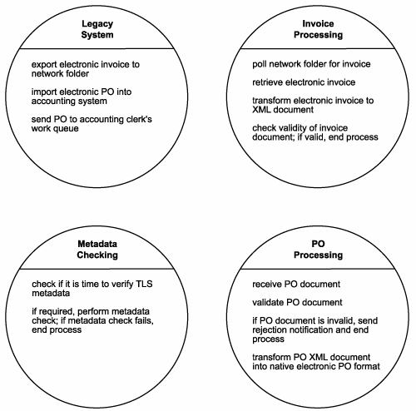
From service candidates to refined service candidates during service analysis

Slide 81
Further refinements during service design

Slide 82
Service design
In this phase, we got our abstract part of WSDL, we still need to design a full WSDL

Slide 84
Service design
What happens after service design, what is the next step in SOA delivery lifecycle?

Slide 85
Service development
Actual construction phase

Slide 86
Service development
Actual construction phase
The choice of programming language

Slide 87
Service development
Actual construction phase
The choice of programming language
The choice of development environment

Slide 88
Open Question
Points: 10
What are some examples of service development technologies?
Open Question is only supported on Version 2.0 or newer.
Answer

Slide 89
Summary

Slide 90
Module 6 Summary
SOA lifecycle and SOA delivery strategies
How to conduct service-oriented analysis
How to design services

